Slide 1
ECPRD Seminar: structures and procedures with regard to the code of conduct for MPs and with regard to the integrity of parliamentary staff presentation: Netherlands House of Representatives Nico Bal Piet van Rijn

Slide 2
Integrity MPs
Oath/promise
Three registers
Voluntary
http://www.houseofrepresentatives.nl/new-members-house-representatives

Slide 3
Integrity MPs
Additional activities (paid/unpaid)
Gifts
Trips
www.tweedekamer.nl

Slide 4
Integrity staff
Reader (translated documents)
Oath/promise
Code of conduct (intranet)

Slide 5
Integrity staff
Staff manual

Slide 6
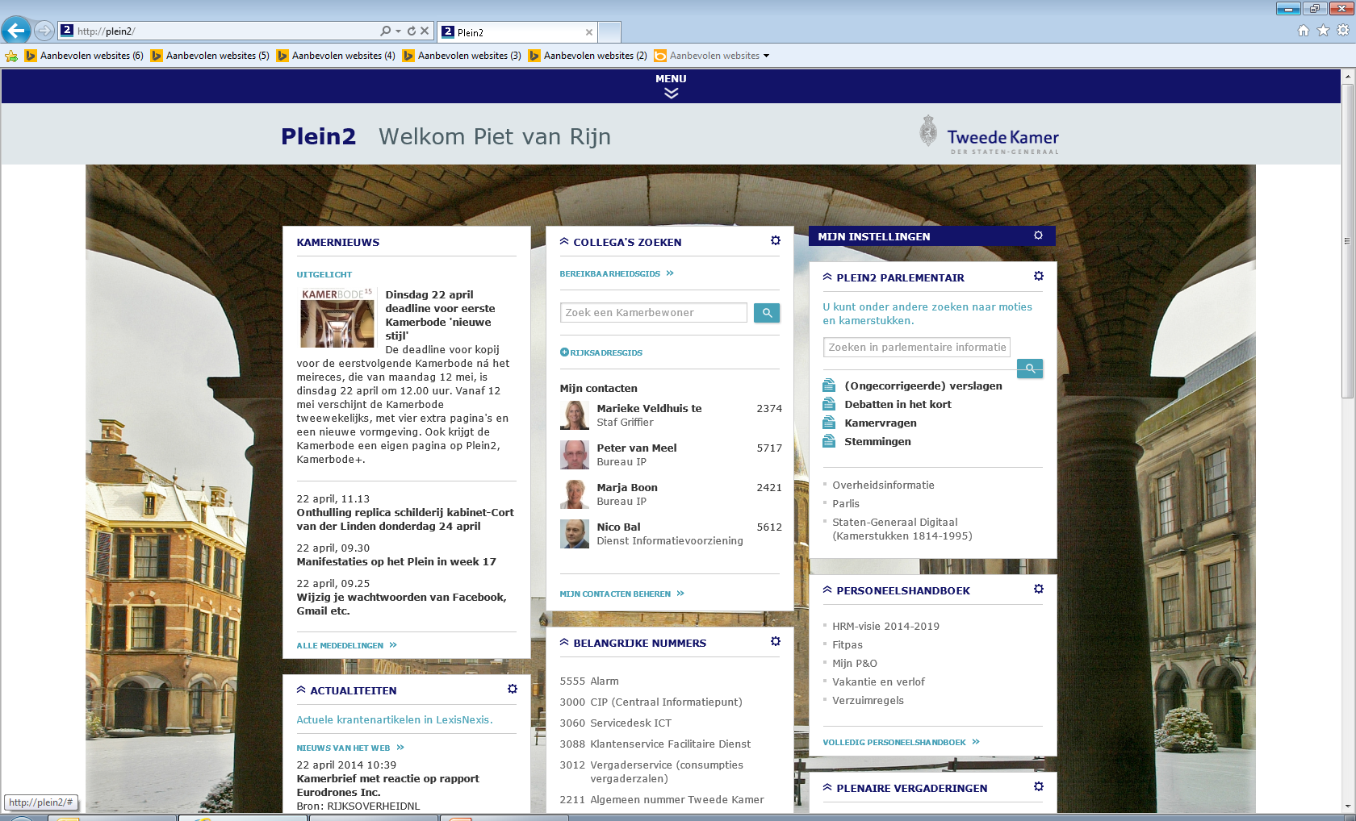

Slide 7
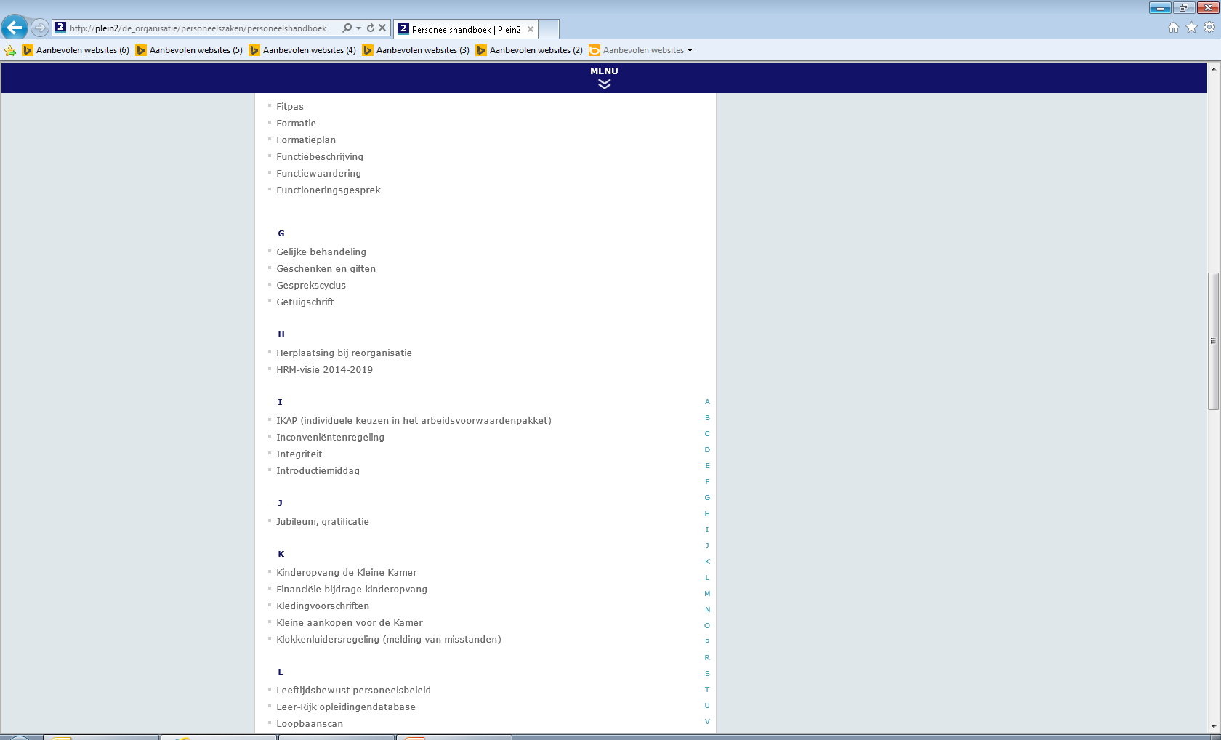

Slide 8
Integrity staff
Clickable references
code of conduct integrity
Code of conduct internet and e-mail use
Flow chart confidential advisors

Slide 9
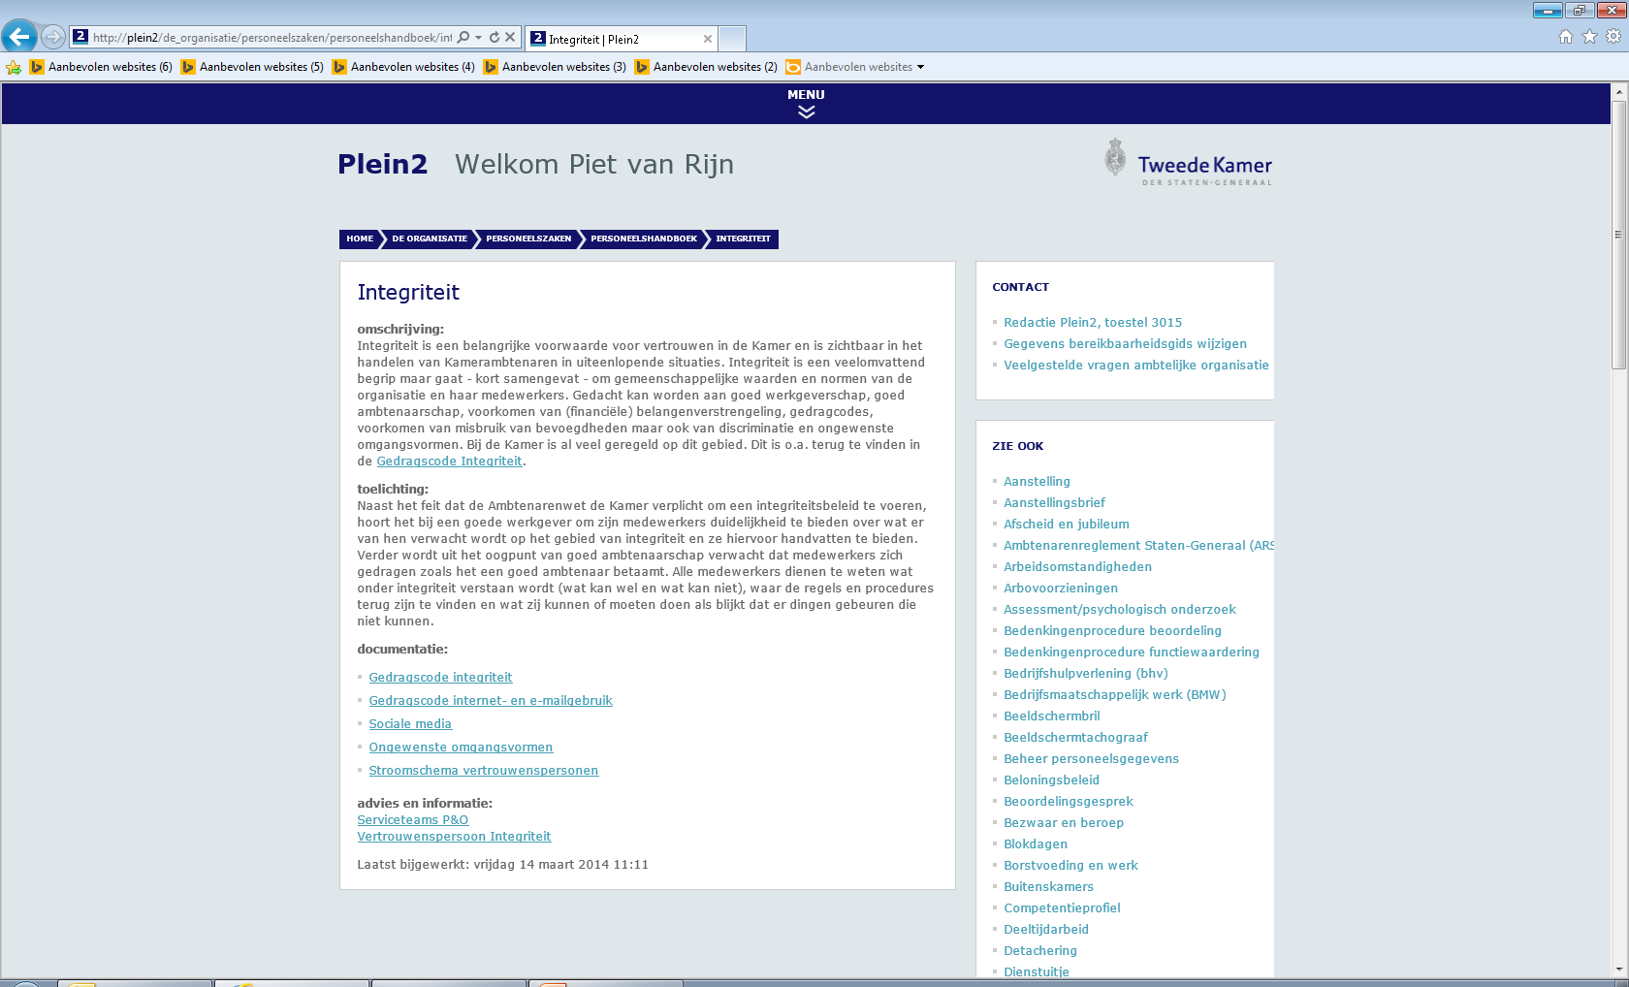

Slide 10
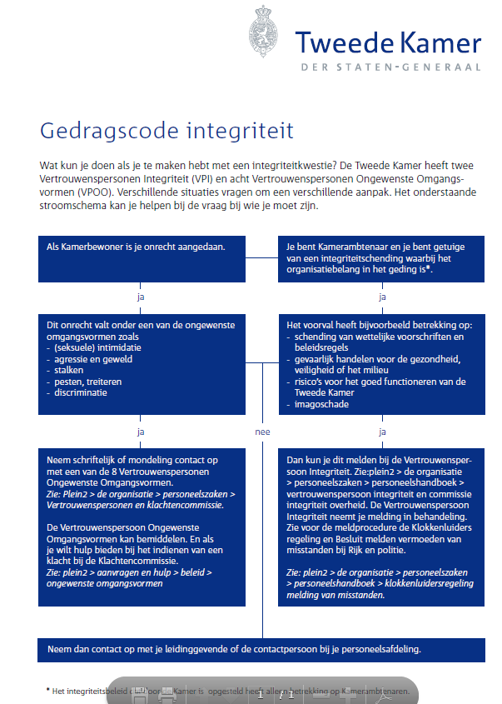
Integrity staff
Code of conduct integrity

Slide 11
Integrity staff
Confidential advisors
Political
Parl. Staff
Complaints committee (mixed)

Slide 13
Integrity staff
Code of conduct integrity (full document on intranet)

Slide 14
Integrity staff
Nico Bal
Experiences as an elected member of the Works Council

